Slide 1
Language Understanding
“Find me a wireless mouse at $30”
Identify INTENT : {findItem, buyItem, addToCart, …}
Identify ENTITIES :
Product: wireless mouse
Price {
Value:30
Currency: USD
}

Slide 2




Language Understanding (LUIS) Machine learning-based service to build natural language into apps, bots, and IoT devices. Quickly create enterprise-ready, custom models that continuously improve.
Add natural language to your apps
Quickly build a custom language solution
Always learning & improving
Enterprise-ready, available worldwide
Leverages customizable pre-built apps and entity dictionaries, (e.g. Calendar, Music, Devices).
Dictionaries are mined from the collective knowledge of the web and supply billions of entries, helping your model to correctly identify valuable information from user conversations.
LUIS integrates seamlessly with the Azure Bot Service, making it easy to create a sophisticated bot.
Designed to identify valuable information in conversations, LUIS interprets user goals (intents) and distills valuable information from sentences (entities), for a high quality, nuanced language model.
Custom Models can be created based on the same technology in Azure Machine Learning
The service is ready to be deployed in commercial applications and can scale with enterprise quality and performance.
The service meets international compliance standards, supports 12 languages and available worldwide, making it highly accessible around the world
Active learning is used to continuously improve the quality of the natural language models.
Once the model starts processing input, LUIS begins active learning, allowing you to constantly update and improve the model.

Slide 3
LUIS
Language Understanding
Train by providing examples
Deploy to an HTTP endpoint and activate on any device
Create your own LU model
Maintain model with ease

Slide 4
Scenario
Contoso is an online retailer with a customer-obsessed culture
Feedback is received across multiple channels
Shoppers should be able to inquire about products and provide feedback

Slide 5








Solution Overview
Functional Scope
Shopping
Support
Feedback
Social Media Feedback Monitoring & Response
Language Understanding
Language Translation
Sentiment Analysis
Speech Recognition
Spell Check
Bot servicing product queries and feedback
Feedback Analytics
INTELLIGENT CORE
Speech enabled Intelligent desktop app for order tracking

Slide 6
Technical Stack
Bot Framework
Azure Table
Azure App Service
LUIS
QnA Maker
Bing Custom Search
Cognitive Services
Bing Spell Check
Sentiment Analysis
Language Translation
Power BI
Application Insights
Platform Services
Azure SQL

Slide 7
LUIS Schema
Please add pizza cheese to my cart.
Can you add tide laundry powder to my cart?
Add to cart
Add to cart
Buy Item
Buy Item
I am looking for a red jacket for men.
Can you find a wireless mouse for me?
Bing Custom Search
Shopping
Find Item
Find Item
Where is my order 456378?
Can you please track my order 783275832?
Speech Integration
Track Order
Support
Track Order
Connect with Human
This is not helping.
Can you connect me to a customer service agent?
Connect with Human
Policy / Rules
Feedback
Policy / Rules
What is the return policy?
How many days does it take to get my refund?
QnA Maker
Search & Browse
Search & Browse
Ordering
Top Level Intents
Ordering
I've received my phone with broken packaging.
Thanks for the timely delivery of my laptop.
Sentiment Analytics
Shipping & Delivery
Shipping & Delivery
Returns & Refunds
I have not received my refund even after 10 days. Can you please look into it?
I requested to return my broken toy, but no one has come to pick it up.
Child Level Intents

Slide 8
A Deeper Look at LUIS

Slide 9
Development Lifecycle: LUIS
An iterative approach using Active Learning
Define Schema
Add training examples
Add features
Test
Publish
< repeat >
Active Learning

Slide 10
Build Models with Less Effort
Active learning focuses labeling where it matters
Prebuilt entities (DateTime, Numbers, Units, Geography, Email, …)
Custom prebuilt domains (Calendar, Music, Weather, Communication, …)
Semantic Dictionaries allow dynamically expanding any list (e.g. 120 Rolling Stone songs, or fruits, or companies, etc.)

Slide 11
Machine Teaching
LUIS is taking the machine teaching approach
Machine Teaching ≠ Machine Learning
"Machine Teaching" is about helping teachers transfer knowledge to machine learning algorithms
"Machine Teaching" is about creating useful models form this knowledge.
There is large community working on this.
The two fields complement each other

Slide 12
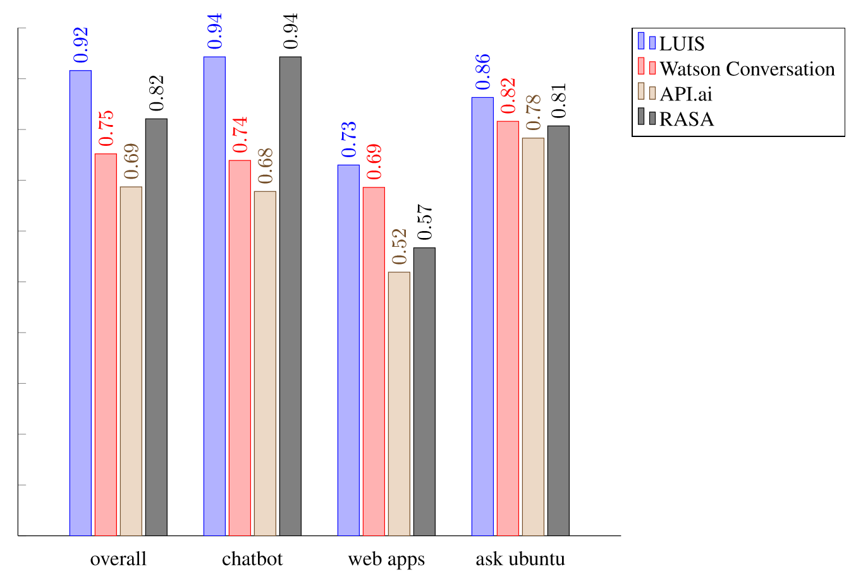
AI Quality Scorecard
SIGDIAL paper comparing LUIS to API.AI and IBM Watson from research team at TUM
“LUIS always performs best, independent from the domain, API.ai always worst, also independent from the domain, merely the second and third place changes.”
LUIS and Watson are close in intent performance while LUIS is much better in entity detection

Slide 13
LUIS Best Practices

Slide 14
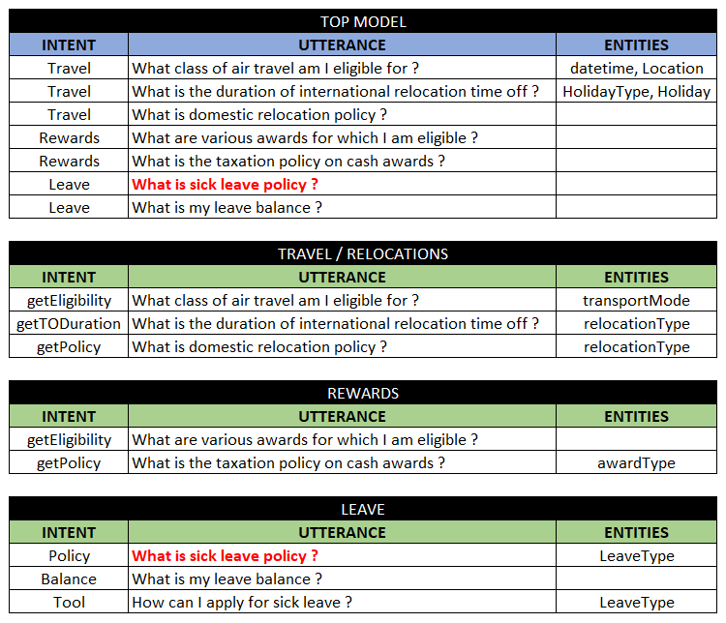
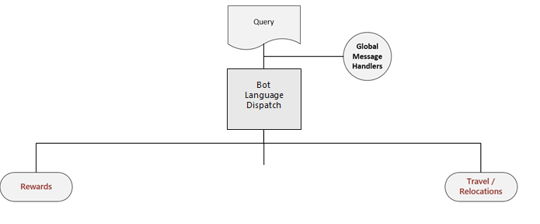

Reference Architecture
“What is sick leave policy”
Rewards
Leave
Travel/
Relocations

Slide 15
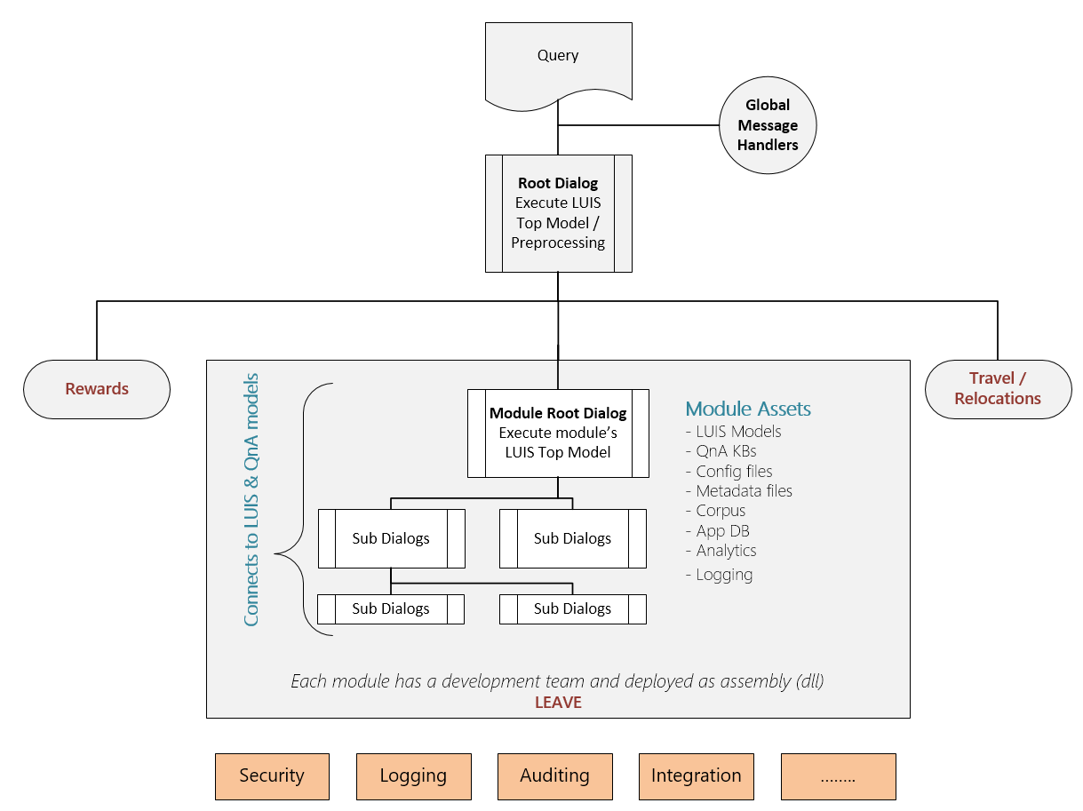
Reference Architecture
“What is sick leave policy”
Bot Language Dispatch

Slide 16
DOs
DON’Ts
Define discriminative intents
Find a sweet spot between too generic & too specific
Build your app iteratively
Add phrase lists & patterns in later iterations
Add examples to NONE (proportional to other intents)
Leverage the suggest feature
Monitor the performance of your app
Add plenty of labels
Use LUIS as a training platform
Add many examples of the same format ignoring other formats
Mix the definition of intents & entities
Create phrase lists with all the possible values
Add so many patterns
Train & publish with every single example

